Slide 1
Kasetsart University, Thailand

Slide 2
Effect of Cross-Cultural Communication on Socio-Cultural Transformations in ASEAN Information Society
Asst.Prof.Porntip Yenjabok,Ph.D
Department of Communication Arts and Information Science,
Faculty of Humanities,
Kasetsart University, Thailand

Slide 3
Use of the Internet in Thailand and ASEAN + 6 Countries in 2010
Source: 1. International Telecommunication Union (ITU), Key 2000-2011 country data (http://www.itu.int/ITU-D/ict/statistics/)
2. National Statistical Office of Thailand (for Thailand data)

Slide 4
ASEAN Statistics (2012)
Asst.Prof.Porntip Yenjabok,Ph.D

Slide 5
ASEAN Statistics (2012)
ASEAN Countries | Population (2012 Est) | Internet users (30/6/2012) | Internet Penetration (%) | FB Users (31/12/2012) | FB Penetration (%)
Brunei Darussalam | 408,786 | 318,900 | 78.0 | 254,760 | 62.3
Cambodia | 14,952,665 | 662,840 | 4.4 | 742,220 | 5.0
Indonesia | 248,645,008 | 55,000,000 | 22.1 | 51,096,860 | 20.6
Laos | 6,586,266 | 592,764 | 9.0 | 255,880 | 3.9
Malaysia | 29,179,952 | 17,723,000 | 60.7 | 13,589,520 | 46.6
Myanmar | 54,584,650 | 534,930 | 1.0 | n/a | n/a
Philippines | 103,775,002 | 33,600,000 | 32.4 | 29,890,900 | 28.8
Singapore | 5,353,494 | 4,015,121 | 75.0 | 2,915,640 | 54.5
Thailand | 67,091,089 | 20,100,000 | 30.0 | 17,721,480 | 26.4
Vietnam | 91,519,289 | 31,034,900 | 33.9 | 10,669,880 | 11.7
Source: National Statistical Office (2012). The 2012 Information and Communication Technology Survey in Household.

Slide 6
Number of computer users by age group
Asst.Prof.Porntip Yenjabok,Ph.D

Slide 7
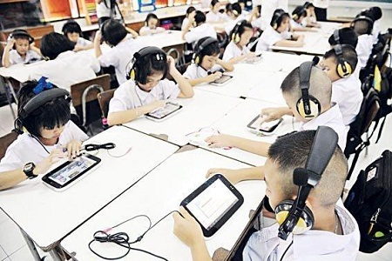
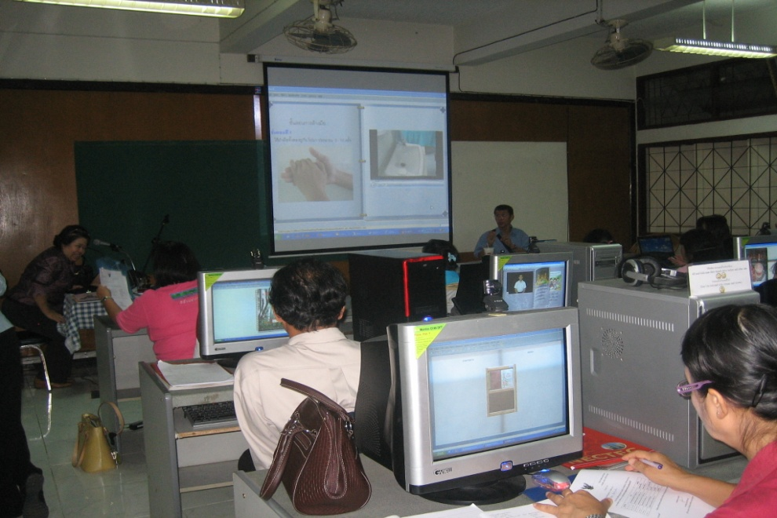
Asst.Prof.Porntip Yenjabok,Ph.D

Slide 8
Number of computer users by location of using group
Asst.Prof.Porntip Yenjabok,Ph.D

Slide 9
Percentage of computer users by activity computer using
Asst.Prof.Porntip Yenjabok,Ph.D

Slide 10
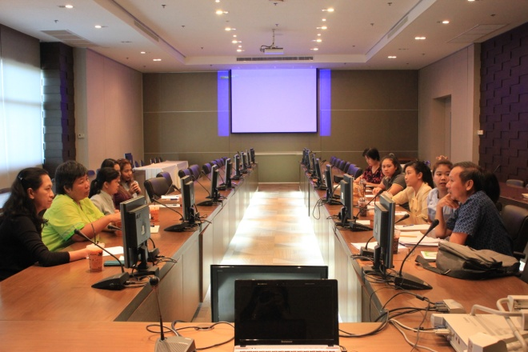
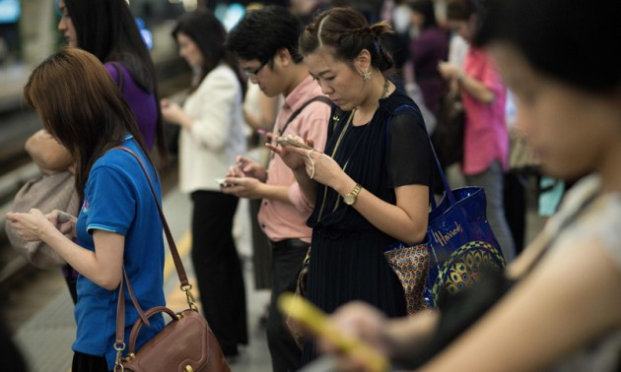
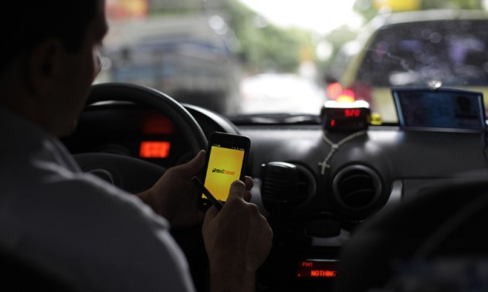
Asst.Prof.Porntip Yenjabok,Ph.D

Slide 12
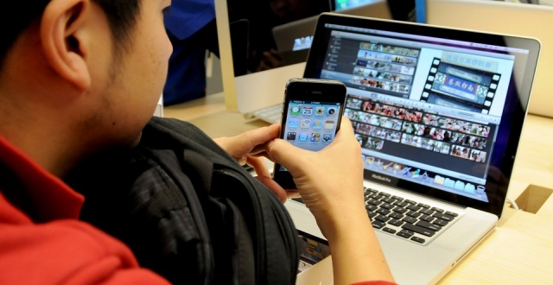
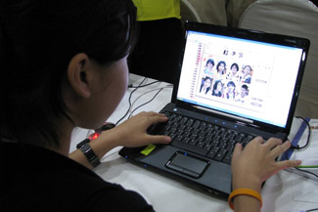
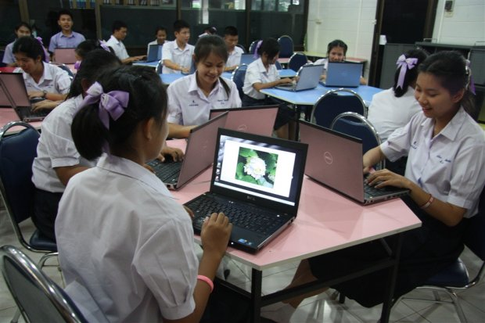
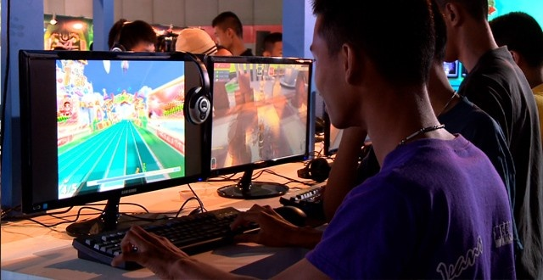
Asst.Prof.Porntip Yenjabok,Ph.D

Slide 13
Number of Internet users by time to access Internet
Asst.Prof.Porntip Yenjabok,Ph.D

Slide 14
Objectives of the research
To investigate the media exposure behavior of cross-cultural communication on socio-cultural transformations in ASEAN information society.
To study some cultural changes in ASEAN countries predominated by cross-cultural communication from other countries.
Asst.Prof.Porntip Yenjabok,Ph.D

Slide 15
Framework of the research
Factors affected on transformations and losses of original culture in ASEAN information society
Demography
- Gender
- Occupation
- Income
- Graduation
- Area
Transformations and Losses of original culture in ASEAN information society
- Ways of life
- Lifestyle patterns in a family
- Food
- Costume
- Media usage
Media exposure behavior
- Time
- Period of time
- Frequency
- Type of program
- Objective
Asst.Prof.Porntip Yenjabok,Ph.D

Slide 16
Research Method
Qualitative and Quantitative Research--the in-depth interview research and content analysis
This study was operated in Thailand.
Focusing on mainstream media (free TV and cable TV) and online media (website, facebook, and social networks)
Asst.Prof.Porntip Yenjabok,Ph.D

Slide 17
Result of the research
All population, aged 15 years and over, always use the ICT at home every day.
Most of them will spend an hour to two hours a day on ICT.
Most of them will use the ICT for contacting with others.
Most of students, aged 15 to 24 years old, will use the application of Line but most of the population aged 25 years and over will use the internet.
Asst.Prof.Porntip Yenjabok,Ph.D

Slide 18
Comparison of ICT usage ranking between students and population aged 25 years and over
Types of ICT | Percent of Students | Percent of population aged 25 years and over
Internet | 19 | 44
Facebook | 27 | 33
Twitter | 10 | 2
Line | 31 | 12
Social Network | 10 | 10
Others | 3 | 0
Total | 100 | 100
Asst.Prof.Porntip Yenjabok,Ph.D

Slide 19
Conclusion
Factors affected on transformations and losses of original culture in ASEAN information society.
Policy of the broadcasting TV stations
Free trade area for the information and communication technology
Modernization of ICT
Asst.Prof.Porntip Yenjabok,Ph.D

Slide 20
Conclusion
Transformations and Losses of original culture in ASEAN information society.
Culture of Language
Culture for time-consuming
Exporting some cross-cultural communications on Socio-Cultural Transformations in ASEAN Information Society
Asst.Prof.Porntip Yenjabok,Ph.D

Slide 21
Conclusion
Ways of life have been changed by the ICT media usage.
All population will use all kinds of the ICT media increasingly.
Everyone likes to open one’s privacy to public increasingly.
More population in the society has a chance to participate in public interests.
Asst.Prof.Porntip Yenjabok,Ph.D

Slide 22
Conclusion
Obviously, examples of cultural changes in Thailand and Laos have predominated by cross-cultural communication from South Korea effectively.
It causes some cultural changes by passing the ICT media—online media, website, twitter, facebook, line, youtube, and Korean fanpage.
Asst.Prof.Porntip Yenjabok,Ph.D

Slide 23
Conclusion
Exporting main cross-cultural communications on Socio-Cultural Transformations in Thailand and Laos.
Entertainment: concerts, shows, series, songs, movies, meet and greet parties, news, etc.
Surgical operation
Tourism
Healthy products
Fashion – costumes and cosmetics
Korean study – language and culture
ICT accessories and appliances
Asst.Prof.Porntip Yenjabok,Ph.D

Slide 24
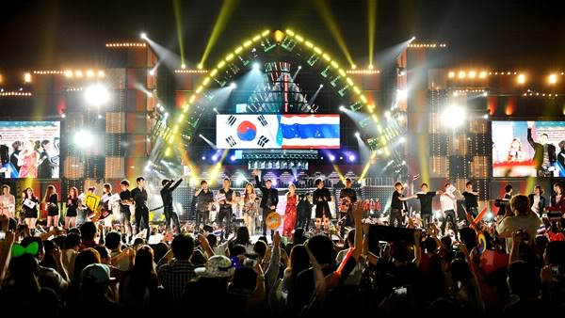
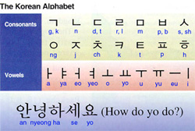
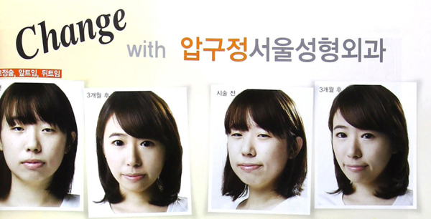
Asst.Prof.Porntip Yenjabok,Ph.D

Slide 25
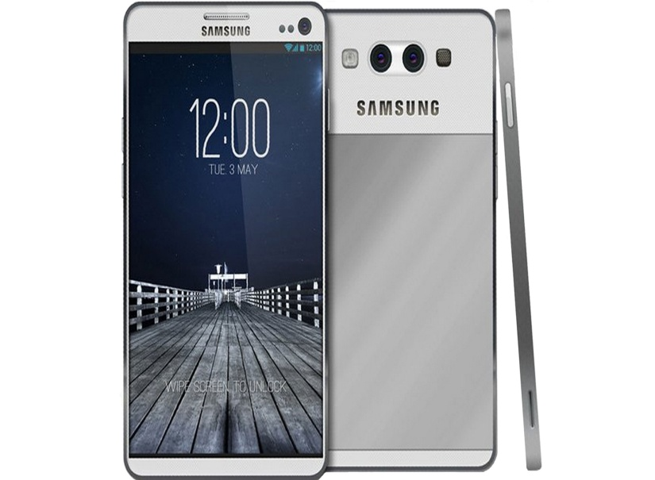
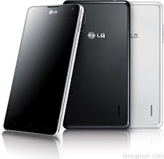
Asst.Prof.Porntip Yenjabok,Ph.D

Slide 26
On-going process
The further research is being studied in Laos, Cambodia, and other ASEAN countries to complete the perfect research.
Finally, the result can be compared and analyzed in the final step.

Slide 27
ICT Master Plan – Smart Thailand
Asst.Prof.Porntip Yenjabok,Ph.D

Slide 28
ICT2020 - Smart Thailand 2020
Goals
A universal broadband access.
75 percent of the population will have information literacy.
ICT professionals will account for at least 3 percent of the workforce.
ICT contribution to GDP at least 18%.
NRI Ranking remains in top 25%
Increased Internet-based Employment
Higher awareness of the role of ICT for environmental sustainability
Asst.Prof.Porntip Yenjabok,Ph.D

Slide 29
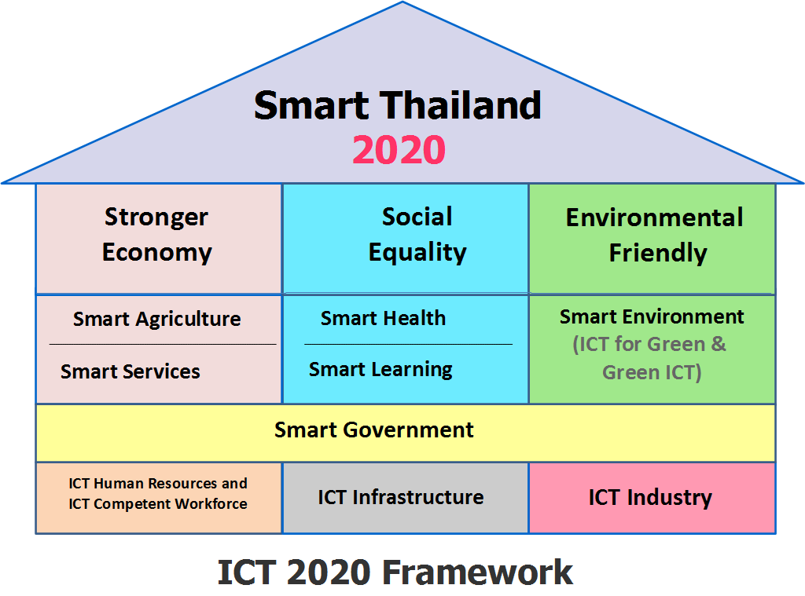

Slide 30
Thank You
Asst.Prof.Porntip Yenjabok,Ph.D

